Slide 1
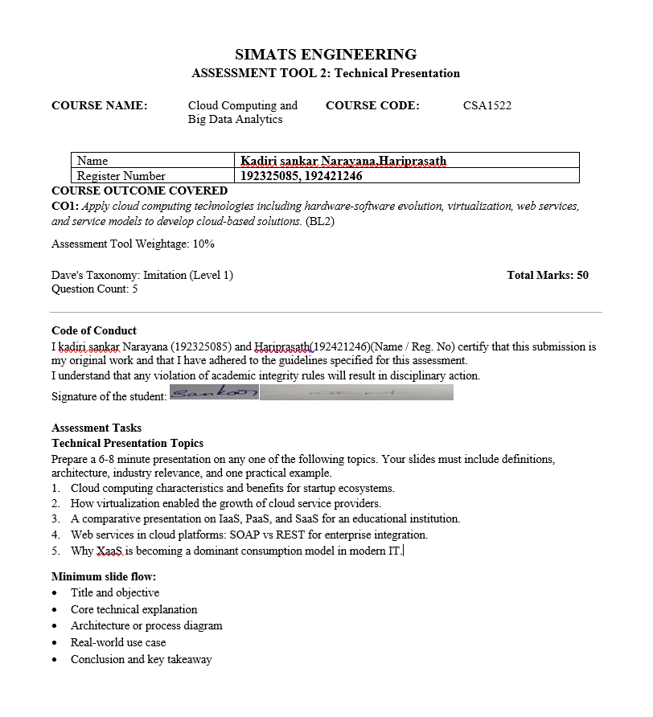

Slide 2
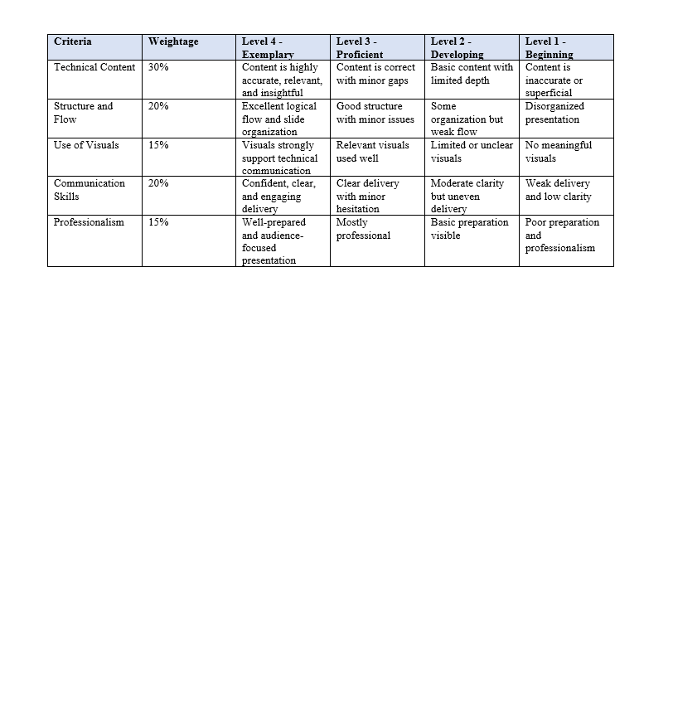

Slide 3
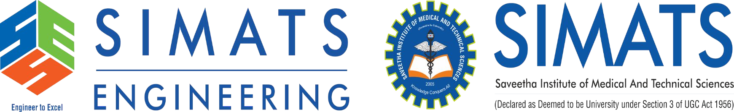
A Comparative Study of Infrastructure as a Service (IaaS), Platform as a Service (PaaS), and Software as a Service (SaaS) for Educational Institutions CSA1522 CLOUD COMPUTING FOR BIG DATA ANALYSIS CO1-AT2-TECHNICAL PRESENTATION
Guided by
DR.P.Rajaram
presented by
Kadiri Sankar Narayana(192325085)
Hariprasath(192421246)

Slide 4
Introduction to Cloud Computing
What is Cloud Computing?
Cloud computing is the delivery of computing services such as servers, storage, databases, networking, and software over the Internet. It allows users to access resources on demand without owning physical infrastructure.
Key Characteristics
On-demand resource availability
Internet-based access
Resource sharing
Automatic scalability
Pay-as-you-use pricing
Why It Matters
Cloud computing reduces costs, improves flexibility, and enables secure access to applications from anywhere.

Slide 5
Objectives & Need for Cloud
Presentation Objectives
Understand cloud computing fundamentals.
Learn the three cloud service models.
Compare IaaS, PaaS, and SaaS.
Explore their architecture and applications.
Understand their role in educational institutions.
Need for Cloud Computing
Reduces infrastructure costs.
Supports remote learning.
Enables collaboration.
Provides high availability.
Improves data backup and recovery.

Slide 6
Infrastructure as a Service (IaaS)
Infrastructure as a Service (IaaS)
IaaS provides virtual computing resources such as servers, storage, and networking over the Internet.
Features
Virtual Machines
Cloud Storage
Networking Services
High Scalability
Flexible Resource Allocation
Advantages
Full infrastructure control
Cost-effective
Easy resource expansion
Examples
AWS EC2, Azure Virtual Machines, Google Compute Engine

Slide 7
Platform as a Service (PaaS)
Platform as a Service (PaaS)
PaaS provides developers with a complete platform to build, test, and deploy applications without managing servers.
Features
Development Environment
Database Services
Runtime Support
Deployment Tools
Automatic Updates
Advantages
Faster application development
Reduced maintenance
Improved productivity
Examples
Google App Engine, Azure App Service, Heroku

Slide 8
Software as a Service (SaaS)
Software as a Service (SaaS)
SaaS delivers ready-to-use software applications through a web browser. Users only need an Internet connection to access the software.
Features
Browser-based access
Subscription model
Automatic updates
Easy collaboration
Multi-device support
Examples
Google Classroom, Microsoft 365, Zoom, Salesforce

Slide 9
Comparison of IaaS, PaaS and SaaS
Feature | IaaS | PaaS | SaaS
Main Users | IT Teams | Developers | End Users
User Control | High | Medium | Low
Maintenance | User | Shared | Provider
Deployment | Flexible | Fast | Instant
Cost | Medium | Medium | Subscription
Examples | AWS EC2 | App Engine | Google Classroom
Key Point
As we move from IaaS → PaaS → SaaS, the cloud provider manages more services while the user manages fewer.

Slide 10
Cloud Architecture
Cloud Service Architecture
Cloud services are organized into multiple layers, each providing a different level of functionality.
Architecture Layers
Users
│
SaaS
│
PaaS
│
IaaS
│
Physical Infrastructure
Explanation
Users access applications through SaaS.
Developers build applications using PaaS.
IaaS provides virtual infrastructure.
Physical servers are managed by the cloud provider.

Slide 11
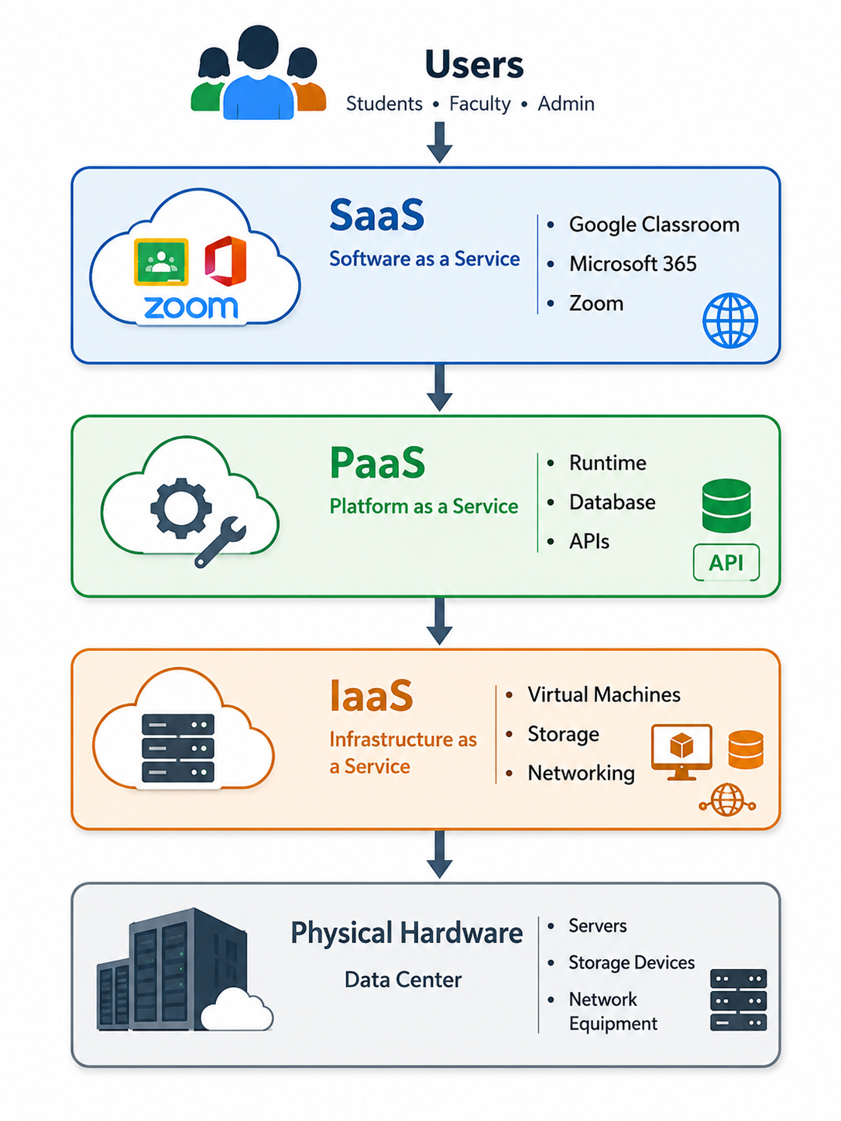

Slide 12
Educational Institution Use Case
Cloud Computing in Education
Educational institutions use cloud services to improve learning, administration, and collaboration.
Applications
Student Information Systems (IaaS)
Online Examination Portal (PaaS)
Google Classroom (SaaS)
Microsoft Teams
Cloud Storage for Research Data
Benefits
Remote learning
Secure data management
Easy collaboration
Reduced IT costs

Slide 13
Industry Relevance, Conclusion & References
Industry Relevance
Cloud computing is widely used in:
Education
Healthcare
Banking
Retail
Manufacturing
Government
Conclusion
IaaS provides flexible infrastructure.
PaaS accelerates application development.
SaaS delivers ready-to-use software.
Educational institutions benefit through lower costs, better collaboration, and scalable digital learning.
References
NIST Cloud Computing Definition
AWS Documentation
Microsoft Azure Documentation
Google Cloud Documentation

Slide 14
